Slide 1


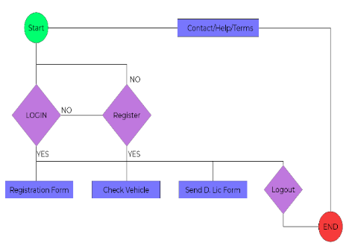
BLOCKCHIAN FOR VEHICLE REGISTRATION
FINAL YEAR PROJECT (2017 – 2021)
DEPARTMENT OF COMPUTER SCIENCE
COMSATS UNIVERSITY ISALAMABAD,
ATTOCK CAMPUS
INTRODUCTION
SYSTEM BACKGROUND
OBJECTIVES
CONCLUSION
Blockchain is the backbone of Digital Cryptocurrency Bitcoin. The Blockchain is a decentralized distributed database. It contains each single data into records for many years without having any chance of loosing it
There are some problems with the existing systems which are identified below:
Use of paper and pen extensively.
Calling person for authentication of papers is uncomfortable.
Chances for the mistakes are high while registering the vehicle.
Inconvenience and non-flexible.
Manual record keeping.
Difficult to analyse the fraud.
Providing an interactive digital menu.
Getting customers’ loyalty.
Eliminating the human error by any means (willingly or unwillingly).
Restaurant Automation will help food lovers to order their favorite food from their smart phones with ease. Also it will greatly help restaurant owners to increase their sales as they will get more orders..
MOTIVATIONS
Increase in vehicle population.
Reduction of frauds in registration.
Reinforce businesses brand image.
Reduce the waiting time period for registration.
GROUP MEMBERS
ARCHITECTURE
Suleman Khan
SP17-BCS-043
Abubakar Bakhtiar
SP17-BCS-050
Shahzaib Hassan
SP17-BCS-034
Supervisor:
Miss TAHIRA SADDAF

